Slide 1
Deterministic Dynamic Programming
Dynamic Programming (DP) determines the optimum solution to an n-variable problem by decomposing it into n stages with each stage constituting a single-variable sub problem.
Recursive Nature of Computations in DP
Computations in DP are done recursively, in the sense that the optimum solution of one sub problem is used as an input to the next sub problem.

Slide 2
By the time the last sub problem is solved, the optimum solution for the entire problem is at hand. The manner in which the recursive computations are carried out depends on how we decompose the original problem.
In particular, the sub problems are normally linked by common constraints. As we move from one sub problem to the next, the feasibility of these common constraints must be maintained.

Slide 3
We illustrate with the famous STAGECOACH problem.
It concerns a mythical fortune seeker in Missouri who decided to go west to join the gold rush in California during the mid-19th century. The journey would require travelling by stagecoach through different states. The possible choices are shown in the figure below. Each state is represented by a circled letter and the direction of

Slide 4
travel is always from left to right in the diagram. Thus, four stages were required to travel from the point of embarkation in state A (Missouri) to his destination in state J (California). The distances between two states are also shown.
Thus the problem is to find the shortest route the fortune-seeker should take.

Slide 5
7
B
1
E
4
6
4
H
3
2
3
4
6
A
C
2
F
J
3
4
3
4
4
3
I
3
1
D
3
G

Slide 6
11
E or F
4
H
7
B
1
E
3
J
4
6
4
H
11
C or
D
3
2
7
E
7
I
3
4
6
A
C
2
F
J
3
4
3
4
4
3
I
3
1
D
3
G
4
J
8
E or
F
6
H

Slide 7
Thus the optimum route will be
C
E
H
A
J
D
F
I
i.e. A C E H J
or A D E H J
with optimum value 11.
or A D F I J

Slide 8
Now we do the same problem by Dynamic programming.
Formulation
Let the decision variables y_{n} (n=1,2,3,4) be the immediate destination on stage n. Thus the route selected is
A y₁ y₂ y₃ y₄
where y₄=J

Slide 9
Let f_{n} (x_{n}, y_{n}) be the total cost of the best overall policy for the remaining stages, given that the fortune seeker is in state x_{n}, ready to start stage n, and selects y_{n} as the immediate destination.
Given n and x_{n}, let y*_{n} denote any value of y_{n} (not necessarily unique) that minimizes f_{n} (x_{n}, y_{n}) and let F_{n} (x_{n}) be the corresponding minimum value of

Slide 10
Thus
where
f_{n} (x_{n}, y_{n}) = immediate cost (stage n) +
minimum future cost (stages n+1 onward)
and x_{n+1} = T_{n}(x_{n}, y_{n}), state into which the system is transformed by the choice of y_{n}.

Slide 11
The values of for various x_{n} and y_{n}
are given in the problem.
For example c_{E,H} = 1 (n = 3, x_{n}= E, y_{n}=H)
The objective is to find F₁(A) and the corresponding route. DP finds it by successively finding F₄(x₄), F₃(x₃), F₂(x₂) for each of the possible states x_{i} and then using F₂(x₂) to solve for F₁(A).

Slide 12
Solution
n=4. Here F₄(x₄) = c(x₄, y₄)
(There is only one entry to minimize)
x₄ | F₄(x₄) | y₄*
H | 3 | J
I | 4 | J

Slide 13
n=3. Here f₃(x₃, y₃) = + F₄(x₄)
y₃
f₃(x₃, y₃)
x₃
F₃(x₃)
y₃*
H
I
E | 1+3=4 | 4+4=8 | 4 | H
F | 6+3=9 | 3+4=7 | 7 | I
G | 3+3=6 | 3+4=7 | 6 | H

Slide 14
n=2. Here
y₂
f₂(x₂, y₂)
F₂(x₂)
y₂*
x₂
E
F
G
B | 7+4=11 | 4+7=11 | 6+6=12 | 11 | E or F
C | 3+4=7 | 2+7=9 | 4+6=10 | 7 | E
D | 4+4=8 | 1+7=8 | 5+6=11 | 8 | E or F

Slide 15
n=1. Here
y₁
f₁(x₁, y₁)
F₁(x₁)
y₁*
x₁
B
C
D
A | 2+11=13 | 4+7=11 | 3+8=11 | 11 | C or D

Slide 16
Thus the optimum route will be
C
E
H
A
J
D
F
I

Slide 17
i.e. A C E H J
or A D E H J
or A D F I J
with optimum value 11.
Forward Recursion
The same problem can be done by starting from stage 1 and ending with stage 4 as follows:

Slide 18
n=1
f₁(x₁, y₁)
y₀
F₁(x₁)
y₀*
x₁
A
B | 2 | 2 | A
C | 4 | 4 | A
D | 3 | 3 | A

Slide 19
n=2 f₂(x₂, y₂) = c(x₂, y₂) + F₁ (x₁)
y₂
f₂(x₂,y₂)
F₂(x₂)
y₂*
x₂
B
C
D
E | 7+2=9 | 3+4=7 | 4+3=7 | 7 | C or D
F | 4+2=6 | 2+4=6 | 1+3=4 | 4 | D
G | 6+2=8 | 4+4=8 | 3+3=6 | 6 | D

Slide 20
n=3. f₃(x₃ , y₃) = c(x₃ , y₃) + F₂ (x₂)
y₃
f₃(x₃,y₃)
F₃(x₃)
y₃*
x₃
E
F
G
H | 1+7=8 | 6+4=10 | 3+6=9 | 8 | F
I | 4+7=11 | 3+4=7 | 3+6=9 | 7 | F

Slide 21
n=4. f₄ (x₄ , y₄) = c(x₄ , y₄) + F₃ (x₃)
f₄(x₄, y₄)
y₄
F₄(x₄)
y₄*
x₄
H
I
J | 3+8=11 | 4+7=11 | 11 | H or I

Slide 22
C
E
H
A
J
D
F
I

Slide 23
Characteristics of DP problems
We pay special attention to the three basic elements of a DP model:
Definition of the stages
Definition of the alternatives at each stage
Definition of the states for each stage

Slide 24
Richard Bellman's principle of optimality
Future decisions for the remaining stages will constitute an optimal policy regardless of the policy adopted in the previous stages.
This is a self-evident principle .

Slide 25
Rutherford Aris restates the principle in more colloquial terms:
If you don't do the best with what you have happened to have got, you will never do the best with what you should have had.

Slide 26
Points to be noted:
The definition of the state is the most subtle.
We find it helpful to consider the following questions:
What relations bind the stages together?
What information is needed to make feasible decisions at the current stage without re examining the decision made at previous stages?

Slide 27
We shall be looking at the problems where the objective function z can be written as either sum or product of n functions.
Knapsack problem
This classical problem deals with the situation in which a hiker must decide on the most valuable items to carry in a backpack.

Slide 28
There are n items 1,2….n.
We assume that the hiker decides to carry m_{i} number of items i. The weight per unit of item i is w_{i} and r_{i} is the revenue per unit of item i.
The hiker can carry a weight of at most W.
Thus the problem is to find m₁, m₂,…,m_{n} so as to
Maximize
Subject to

Slide 29
Thus in this model, there are n stages, namely the choice of item i, i = 1,2…n.
The alternatives at stage i are represented by the number m_{i} of item i to be included in the knapsack.
The associated return is r_{i}m_{i}.
(Note that m_{i} can take values 0,1,….[W/w_{i}])

Slide 30
The state of stage i is represented by x_{i} , the total weight assigned to stages (items) i, i+1…n.
Thus the weight constraint is the only restriction that links all the stages.
We define F_{i}(x_{i}) = maximum return for stages i, i+1,…, n

Slide 31
Given state x_{i},
We have the recurrence relation
F_{i}(x_{i}) = max {r_{i}m_{i} + F_{i+1}(x_{i+1})}
m_{i} =0,1…,
i = 1,2,…, n
(where F_{n+1}(x_{n+1}) = 0)

Slide 32
Since x_{i} - x_{i+1}= w_{i}m_{i}, the weight used at stage i,
we have F_{i}(x_{i}) = max {r_{i}m_{i} + F_{i+1}(x_{i} - w_{i}m_{i})}
m_{i} =0,1…,
i = 1,2,…, n
Problem 2(a) Problem set 10.3A page 412
Solve the knapsack problem when

Slide 33
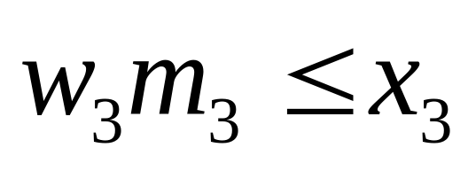
Stage 3
m₃ can assume values 0,1,2,3.
An alternative is feasible only if
Thus we get the following table which gives the optimal return for each value of x₃:

Slide 34
Stage 3. F₃(x₃)= max 40m₃ = max 40[x₃/2]. Note: m₃ can take values 0,1,2,[6/2]=3 (w₃ = 2, r₃ = 40)
40m₃
m₃ x₃ | 0 | 1 | 2 | 3 | F₃(x₃) | m₃*
0 | 0 | - | - | - | 0 | 0
1 | 0 | - | - | - | 0 | 0
2 | 0 | 40 | - | - | 40 | 1
3 | 0 | 40 | - | - | 40 | 1
4 | 0 | 40 | 80 | - | 80 | 2
5 | 0 | 40 | 80 | - | 80 | 2
6 | 0 | 40 | 80 | 120 | 120 | 3

Slide 35
Stage 2. F₂(x₂)=max {20m₂ + F₃(x₂ - m₂)} max m₂=[6/1]=6
m₂
20m₂ + F₃(x₂-m₂)
(w₂ = 1, r₂ = 20)
x₂ | m₂=0 | 1 | 2 | 3 | 4 | 5 | 6 | F₂(x₂) | m₂*
0 | 0 | - | - | - | - | - | - | 0 | 0
1 | 0 | 20 | - | - | - | - | - | 20 | 1
2 | 0+40 = 40 | 20+0 = 20 | 40+0 = 40 | - | - | - | - | 40 | 0 or 2
3 | 0+40 = 40 | 20+40= 60 | 40+0 = 40 | 60+0 = 60 | - | - | - | 60 | 1 or 3
4 | 0+80 = 80 | 20+40= 60 | 40+40= 80 | 60+0 = 60 | 80+0 = 80 | - | - | 80 | 0 or 2 or 4
5 | 0+80 = 80 | 20+80= 100 | 40+40= 80 | 60+40= 100 | 80+0 = 80 | 100+0= 100 | - | 100 | 1 or 3 or 5
6 | 0+120= 120 | 20+80= 100 | 40+80= 120 | 60+40= 100 | 80+40= 120 | 100+0= 100 | 120+0= 120 | 120 | 0 or 2 or 4 or 6

Slide 36
Stage 1. F₁(x₁) = max{70m₁+F₂(x₁-4m₁)} max m₁=[6/4]=1
m₁
(w₁ = 4, r₁ = 70)
70m₁ + F₂(x₁ - 4m₁)
x₁ | m₁=0 | m₁=1 | F₁(x₁) | m₁*
0 | 0+0 = 0 | - | 0 | 0
1 | 0+20 = 20 | - | 20 | 0
2 | 0+40 = 40 | - | 40 | 0
3 | 0+60 = 60 | - | 60 | 0
4 | 0+80 = 80 | 70+0 = 70 | 80 | 0
5 | 0+100 = 100 | 70+20 = 90 | 100 | 0
6 | 0+120 = 120 | 70+40 = 110 | 120 | 0

Slide 37
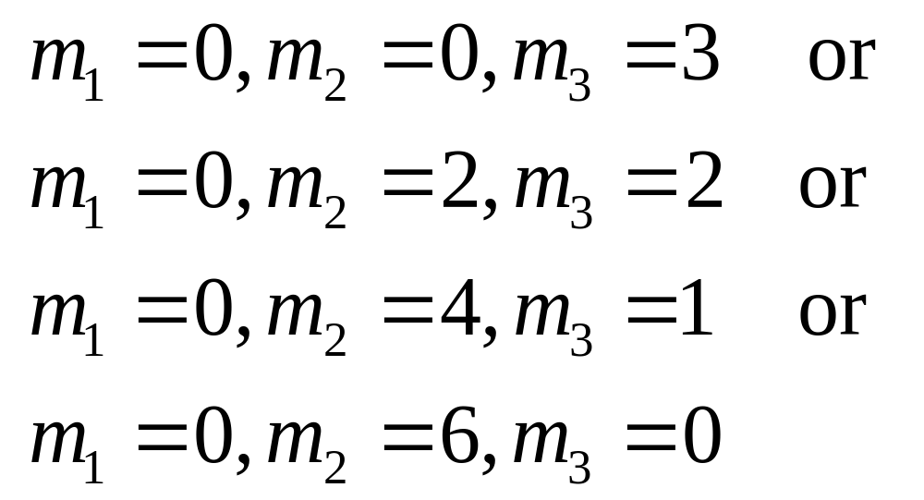
Optimal allocation:

Slide 38
Problem 11.3-2 Hillier and Liebermann Page 571
A college student has 7 days remaining before final examinations begin in her four courses, and she wants to allocate this study time as effectively as possible. She needs at least one day for each course, and she likes to concentrate on just one course each day, so she wants to allocate 1, 2, 3 or 4 days to each course. (Problem continues …)

Slide 39
Having recently taken the optimization course, she decides to use dynamic programming to make these allocations to maximize the total grade points to be obtained from the four courses. She estimates that the alternative allocations for each course would yield the number of grade points shown in the following table. Solve the problem by DP.

Slide 40
Estimated grade points
Course
Study days | 1 | 2 | 3 | 4
1 | 3 | 5 | 2 | 6
2 | 5 | 5 | 4 | 7
3 | 6 | 6 | 7 | 9
4 | 7 | 9 | 8 | 9

Slide 41
Solution
There are four stages. At stage i, let x_{i} denote the number of days left for study. Let y_{i} denote the number of days allocated for course i.
Let r_{i}(y_{i}) be the return (= grade points got) when y_{i} days are allocated to course i.
Let F_{i}(x_{i}) be the optimum return for stages i, i+1, …, 4.

Slide 42
Thus F_{i}(x_{i})
where and F₅(x₅) = 0= F₅(x₄-y₄)
F₁(7) gives us the optimal solution to the given problem.

Slide 43
Stage 4. Since the student should devote at least one day for each course,
x₄=1,2,3,4 = y₄
Hence F₄(x₄) = r₄(y₄)
x₄ | F₄(x₄) | y₄*
1 | 6 | 1
2 | 7 | 2
3 | 9 | 3
4 | 9 | 4

Slide 44
Stage 3: x₃ = 2,3,4,5
F₃(x₃) = max {r₃(y₃) + F₄(x₃ - y₃)}
y₃ ≤ x₃
r₃(y₃) + F₄(x₃ - y₃)
 | 1 | 2 | 3 | 4 | F₃(x₃) | y₃*
2 | 2+6= 8 | - | - | - | 8 | 1
3 | 2+7= 9 | 4+6=10 | - | - | 10 | 2
4 | 2+9=11 | 4+7=11 | 7+6=13 | - | 13 | 3
5 | 2+9=11 | 4+9=13 | 7+7=14 | 8+6=14 | 14 | 3 or 4
y₃
x₃

Slide 45
Stage 2:
x₂ = 3, 4, 5, 6
F₂(x₂) = max {r₂(y₂) + F₃(x₂ – y₂)}
y₂ ≤ x₂
r₂(y₂) + F₃(x₂ - y₂)
 | 1 | 2 | 3 | 4 | F₂(x₂) | y₂*
3 | 5+ 8=13 | - | - | - | 13 | 1
4 | 5+10=15 | 5+8 =13 | - | - | 15 | 1
5 | 5+13=18 | 5+10=15 | 6+10=16 | - | 18 | 1
6 | 5+14=19 | 5+13=18 | 6+10=16 | 9+8=17 | 19 | 1
y₂
x₂

Slide 46
Stage 1: Though we should only find F₁(7), we find F₁(x₁) for x₁ = 4, 5, 6, 7.
F₁(x₁) = max {r₁(y₁) + F₂(x₁ – y₁)}
 | 1 | 2 | 3 | 4 | F₁(x₁) | y₁*
4 | 3+13=16 | - | - | - | 16 | 1
5 | 3+16=19 | 5+13=18 | - | - | 19 | 1
6 | 3+18=21 | 5+15=20 | 6+13=19 | - | 21 | 1
7 | 3+19=22 | 5+18=23 | 6+15=21 | 7+13=20 | 23 | 2
y₁
r₁(y₁) + F₂(x₁- y₁)
x₁
Optimum Solution:
y₁ = 2, y₂ = 1, y₃ = 3, y₄ = 1
Optimum Total Grade Points =
F₁(7) =
23

Slide 47
Brute Force Verification
D1 D2 D3 D4 Tot Gr pts
1 | 1 | 1 | 4 | 3+5+2+9=19
1 | 1 | 2 | 3 | 3+5+4+9=21
1 | 1 | 3 | 2 | 3+5+7+7=22
1 | 1 | 4 | 1 | 3+5+8+6=22
1 | 2 | 1 | 3 | 3+5+2+9=19
1 | 2 | 2 | 2 | 3+5+4+7=19

Slide 48
D1 D2 D3 D4 Tot Gr pts
1 | 2 | 3 | 1 | 3+5+7+6=21
1 | 3 | 1 | 2 | 3+6+2+7=18
1 | 3 | 2 | 1 | 3+6+4+6=19
1 | 4 | 1 | 1 | 3+9+2+6=20
2 | 1 | 1 | 3 | 5+5+2+9=21
2 | 1 | 2 | 2 | 5+5+4+7=21
2 | 1 | 3 | 1 | 5+5+7+6=23

Slide 49
D1 D2 D3 D4 Tot Gr pts
2 | 2 | 1 | 2 | 5+5+2+7=19
2 | 2 | 2 | 1 | 5+5+4+6=20
2 | 3 | 1 | 1 | 5+6+2+6=19
3 | 1 | 1 | 2 | 6+5+2+7=20
3 | 1 | 2 | 1 | 6+5+4+6=21
3 | 2 | 1 | 1 | 6+5+2+6=19
4 | 1 | 1 | 1 | 7+5+2+6=20

Slide 50
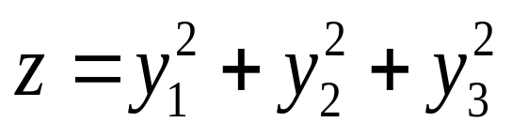
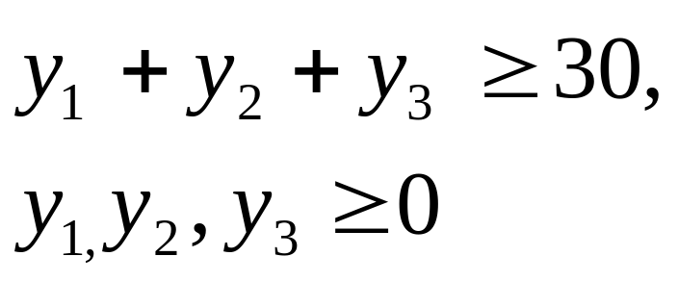
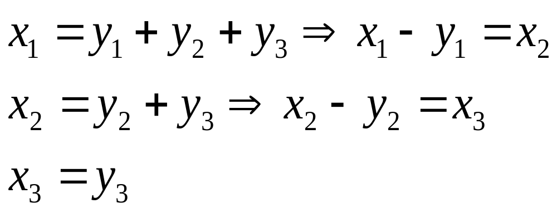
Problem: Use dynamic programming to
Minimize
subject to
Solution:There are three stages: in stage i, we select the variable y_{i}. At stage i, we are in state x_{i} = the sum of the variables y_{i} yet to be decided. Thus

Slide 51
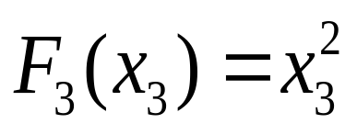
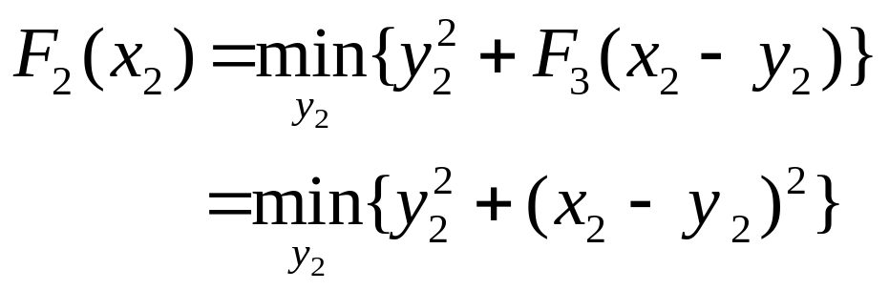
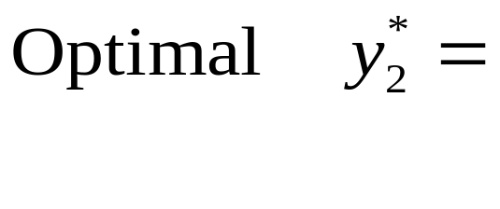
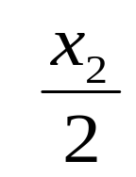
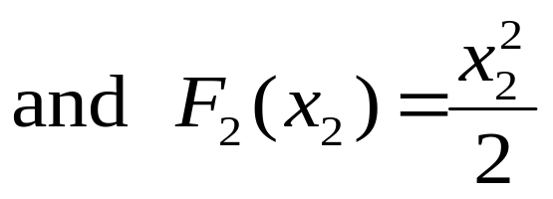
Let F_{i}(x_{i}) = optimal return for stages i,i+1, …, 3
n = 3: Here y₃ can take only one value, namely x₃ and so optimal return
n = 2: Here
Using calculus, we find

Slide 52
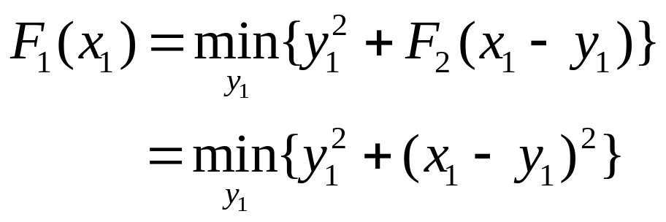
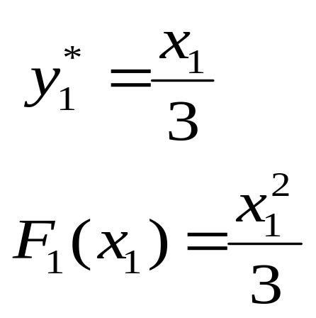
n = 1: Here
Using calculus, we find optimal
Since x₁ ≥ 30, F₁(x₁) is minimum when x₁ = 30
Thus min value of the problem = 300 and is got when y₁ = 10, y₂ = 10, y₃ = 10

